Slide 1
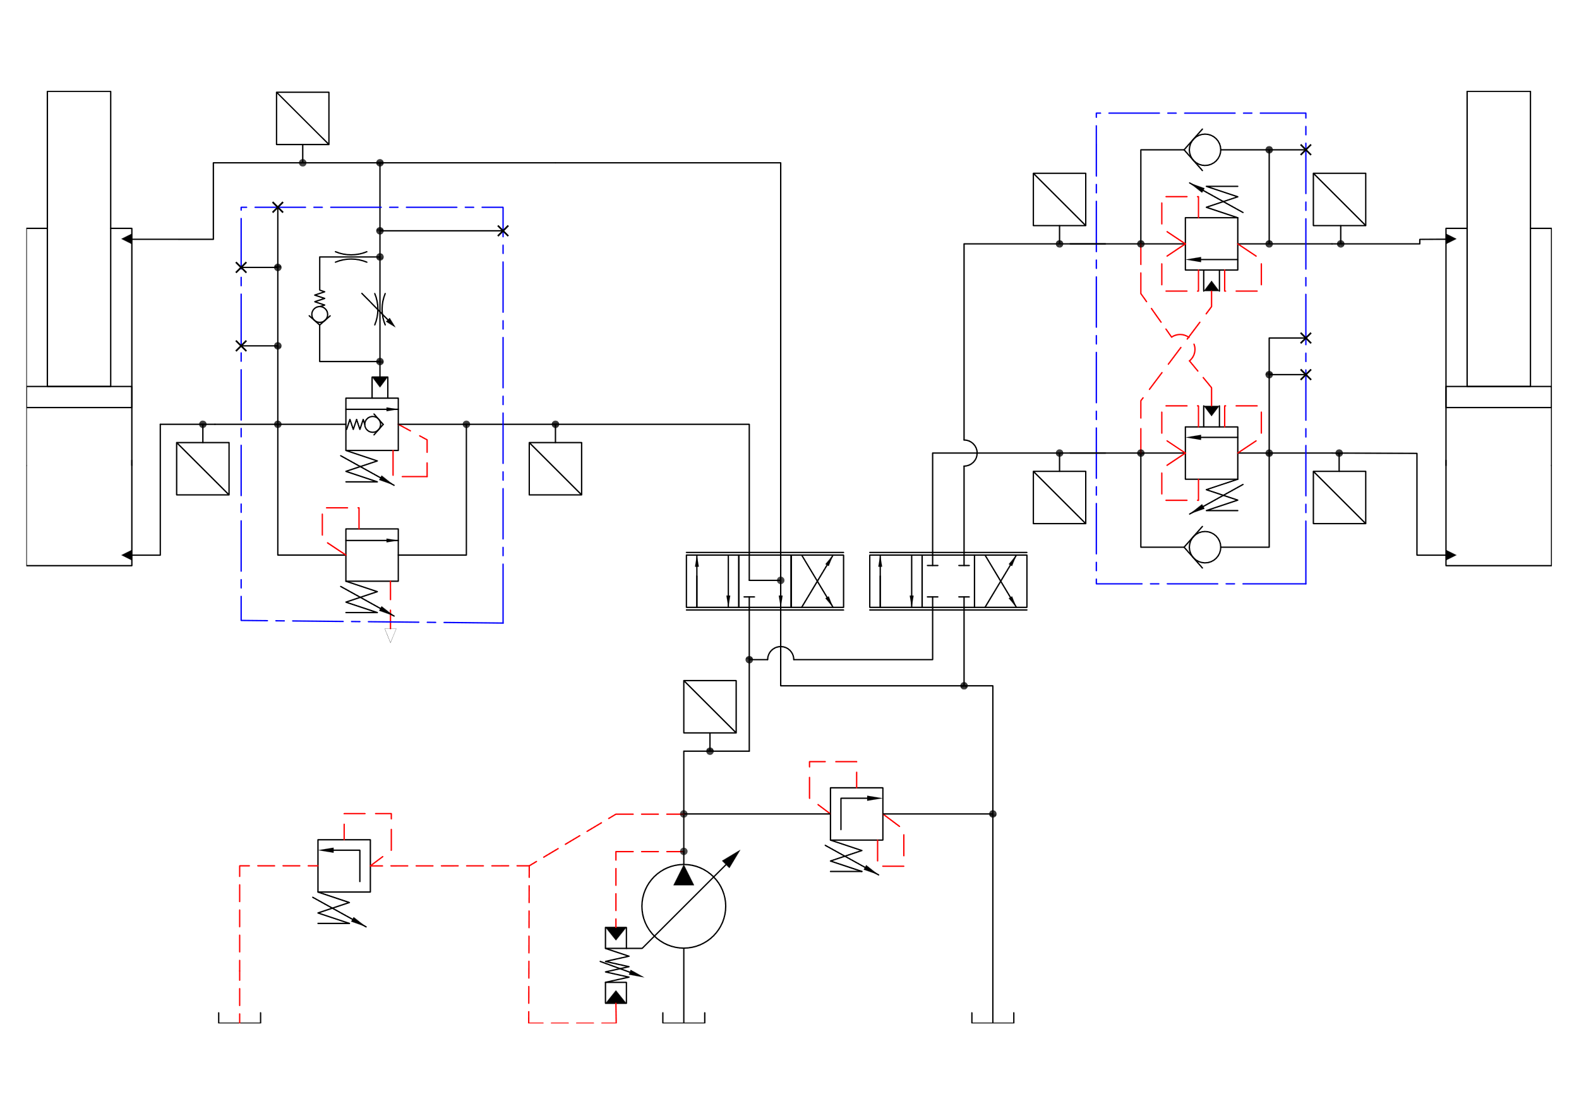
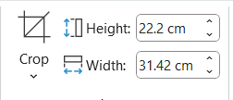
Importing from autocad
Export as pdf from autocad
Convert pdf to svg (https://cloudconvert.com/pdf-to-svg )
Insert svg

Slide 2
U
Components
P
U
U
P
P
3
U
U
P
P
U
U
P
P
8
2
1
5
4
7
U
P
Knucle cylinder
Pressure transduser
Knuckle counter balance valve block
Hawe directional control valve
Hawe directional control valve
Pump
Main counter balance valve block
Main cylinder
6

Slide 3
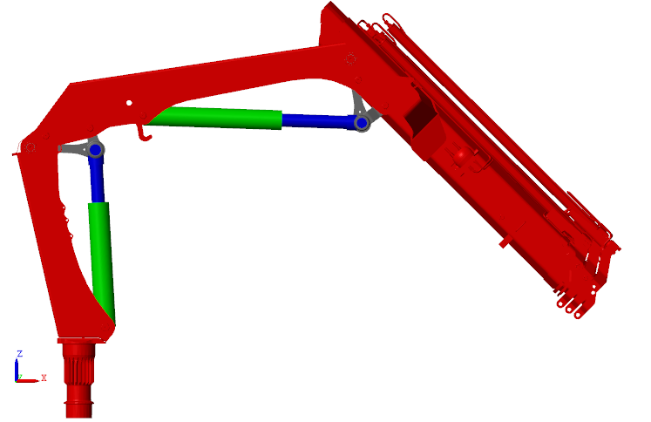
4
3
5
2
Column
Main cylinder
Knucle cylinder
Main arm
Knuckle arm
1

Slide 4
7
U
Simulink
P
1
2
U
U
P
P
9
10
U
U
P
P
U
U
6
5
P
P
4
3
Pb_K_DCV
Pb_K_Cyl
Pa_K_Cyl
Pa_K_DCV
Pa_M_DCV
Pa_M_Cyl
Pb_M
P_supply
Stroke_M_Cyl
Stroke_K_Cyl
8
U
P

Slide 5
7
U
TwinCat
P
1
2
U
U
P
P
9
10
U
U
P
P
U
U
6
5
P
P
4
3
Pb_K_DCV
Pb_K_Cyl
Pa_K_Cyl
Pa_K_DCV
Pa_M_DCV
Pa_M_Cyl
Pb_M
P_supply
Stroke_M_Cyl
Stroke_K_Cyl
8
U
P

